Slide 1
Homezilla : Attracting buyers through better photos
By
Srija Gupta
UIN:656331239

Slide 2
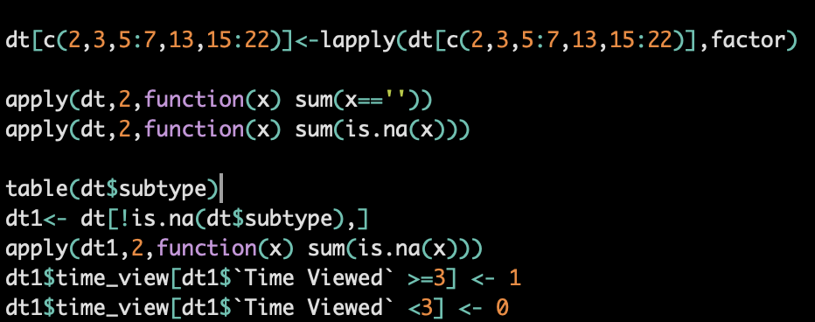
Data Cleaning
Merged the datasets 62 listing properties and Browsing data on Web ID. There were 29491 observations of 24 variables.
Dropped the rows with NA values from subtype and were left with 29470 observation. Converted subtype, bedrooms, bathrooms etc into factors.
Good sign was when Time Viewed was greater than equal to 3 seconds, so a new column time_view was created with time <3 seconds being assigned as “0” and time viewed>=3 seconds was assigned as “1”.
Assuming that a person spends a maximum of 1 minute viewing a particular photo, all rows with Time Viewed data > 60 seconds was dropped.

Slide 3
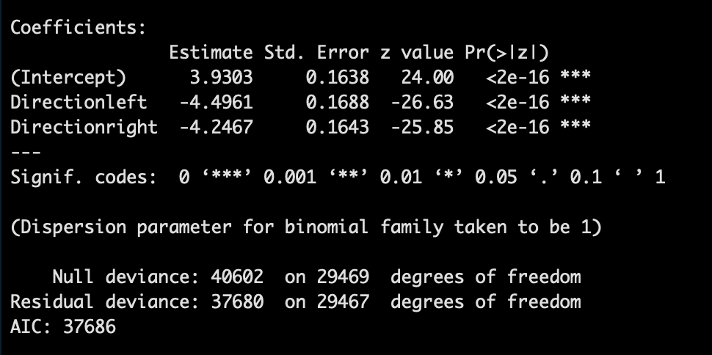
Was the sequence of photos important?
We didn’t have the sequence for the first picture, from this table we can determine the number of unique customer visiting our site ,who really spent more than 3 seconds were approximately 1935/1970= 0.98
Time_View | Firstpage | Left | Right
0 | 38 | 1650 | 14409
1 | 1935 | 937 | 10501
We have more right swiped direction as compared to left swipes, but it is mostly because we read from left to right and also from the data above, we see that time spent on a photo doesn’t depend on whether the user arrived at it from left swipe or right swipe. So, the sequence of photos weren’t important.

Slide 4
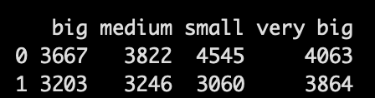
Was the type of photos important?
NUMBER OF BEDROOMS | AREA OF THE PROPERTY
Binned the sqfoot area: area<1000=> small, 1000<=area<=1500 =>medium, 1500<area<=3000 =>big and area>3000 =>very big.
Pictures with houses having 3 bedrooms or 7 bedrooms were mostly viewed longer

Slide 5
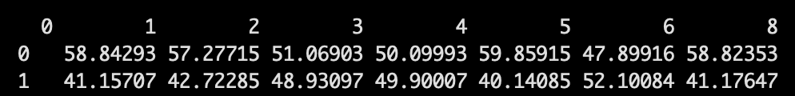
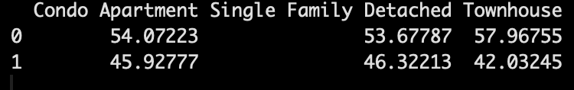
Was the type of photos important?
NUMBER OF BATHROOMS | SUBTYPE: CONDO, DETACHED,TOWNHOUSE
 | Single Family Detached apartments pictures were viewed more ,than the condo apartments’ photo and then townhouse.
Pictures with houses having 4 bathrooms or 6 bathrooms are generally preferred, however, not very significant.

Slide 6
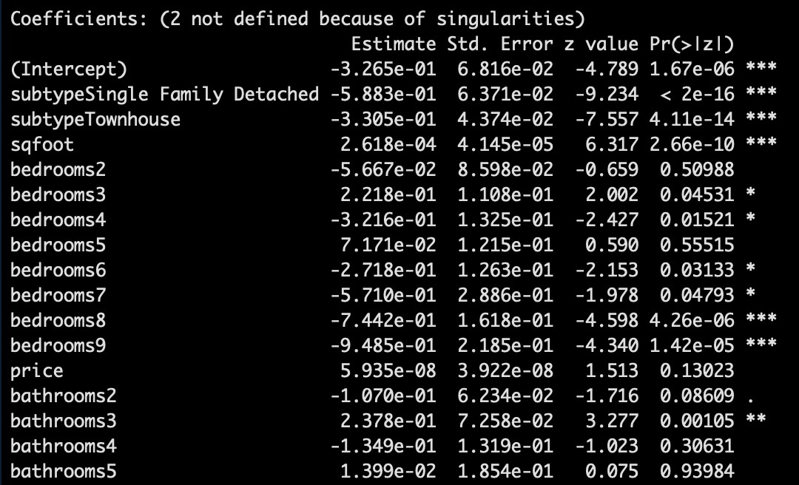
Was the type of photos important?
It can be noted that the following type of photos which had house type as:
Subtype Townhouse, bedrooms and bathrooms were important attributes for house type.
With an unit increase in sqfoot area, the probability of viewing a photo increase by 2.6e-04
With respect of houses with 1 bedroom , if its bedroom 3 the likelihood of time viewed changes by 2.21e-01.
With respect to houses with 1 bathroom , if the house has three bathrooms,the likelihood of the time viewed changes by 2.37e-01

Slide 7
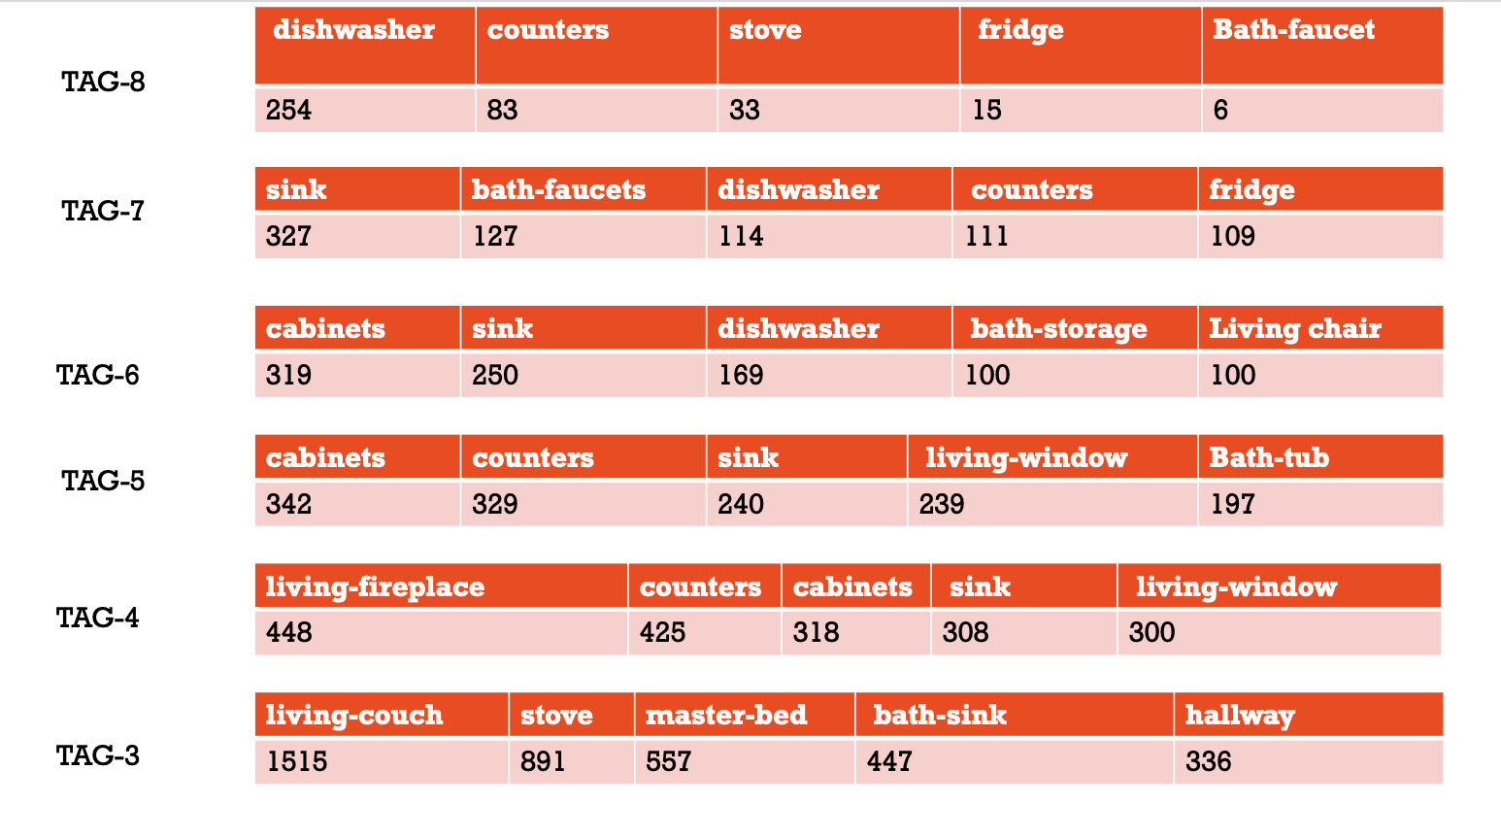
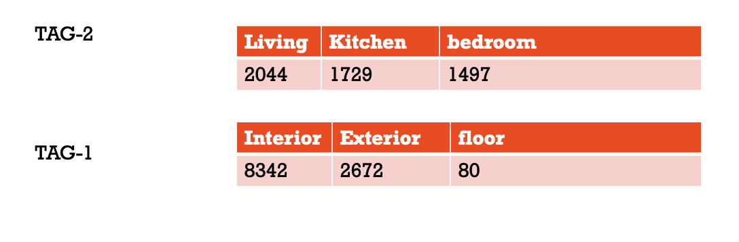
Which Photos were most attractive?
We see that the pictures with:
Dishwasher
Sink
Cabinets
Living-fireplace
Living-Couch
Conclusion: The Interior of the house depicting pictures of Living room, Kitchen,cabinets,counters,sink,fireplace,bath-faucet,dishwasher.

Slide 8
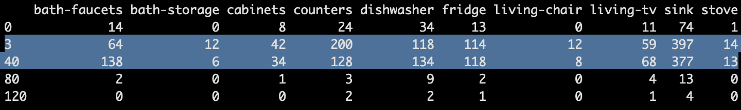
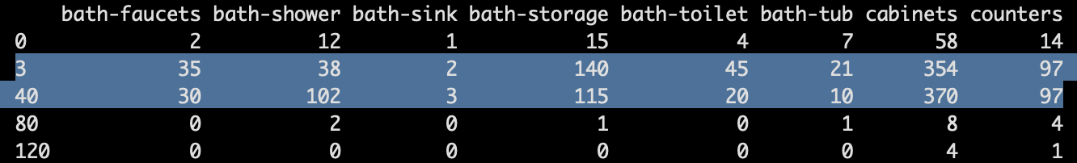
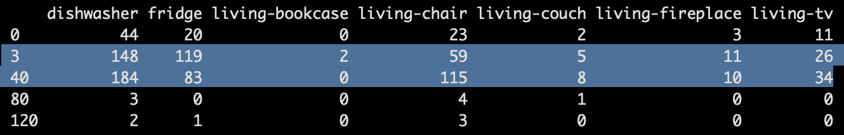
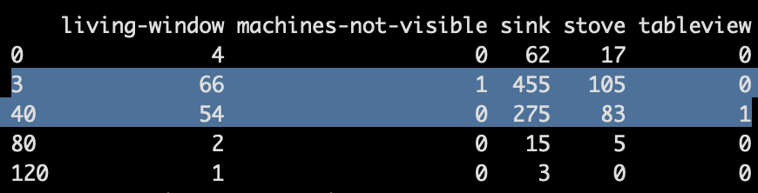
Tag 7: Bath-faucet,dishwasher
Tag 6: bath-shower,living-chair,dishwasher

Slide 9
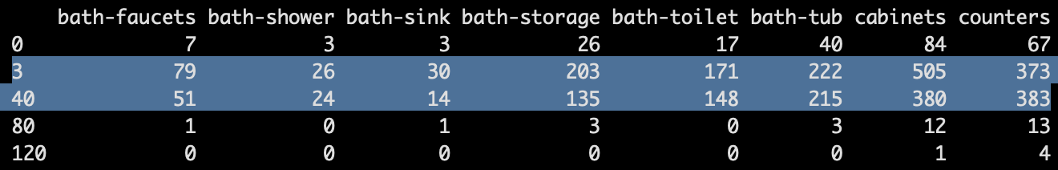
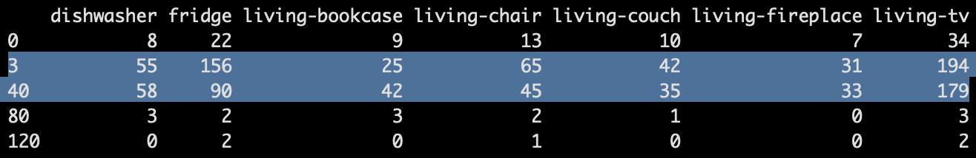
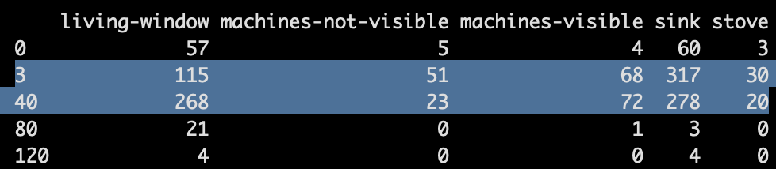
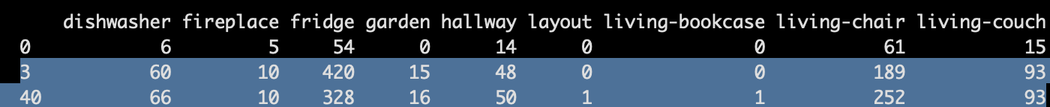
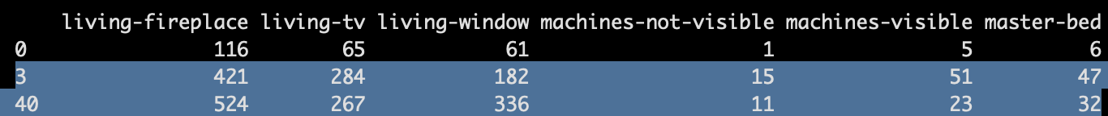
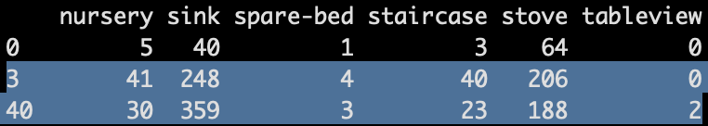
Tag 5: Living-window, Counters, dishwasher, living-fireplace
Tag 4: bath-storage,living chair,living-window, sink

Slide 10
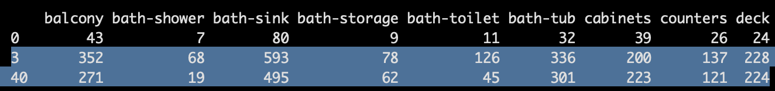
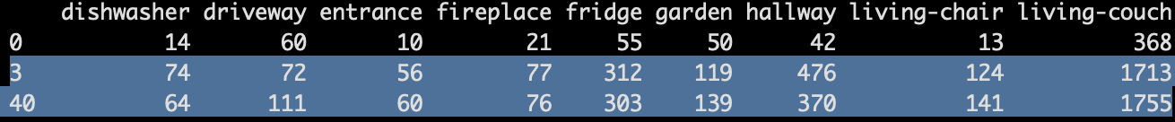
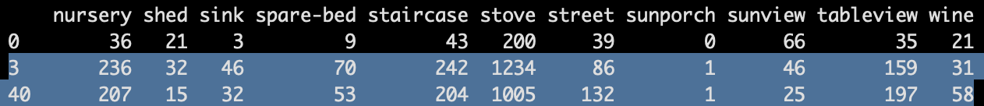
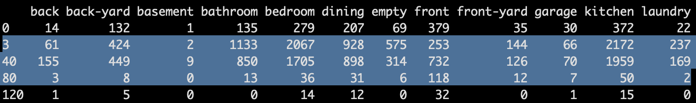
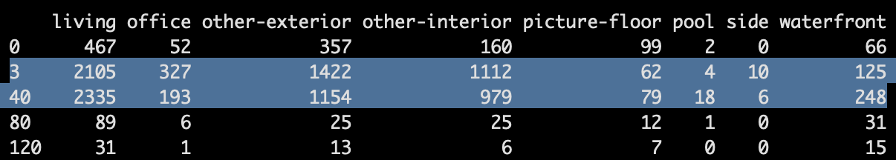
Tag 3: living-chair,living-fireplace, street,garden
Tag 2: water-front,front

Slide 11
Which Photos were most attractive?
Conclusion: Pictures showing Bath-faucet, Bath-shower, living windows, Counters, Sink, living chair, living-window and waterfront were most attractive

